Slide 1
Digital Portfolio
STUDENT NAME: M.BHAVADHARANI
REGISTER NO AND NMID: 67F371D74FA96E2BBB8464801110600D
DEPARTMENT: BSC COMPUTER SCIENCE
COLLEGE: COLLEGE/ UNIVERSITY: TIRUPPUR KUMARAN COLLEGE FOR WOMAN/BHARATHIYAR UNIVERSITY

Slide 2
PROJECT TITLE
WEB DESIGNERS DIGITAL PORTFOLIO

Slide 3


AGENDA
Problem Statement
Project Overview
End Users
Tools and Technologies
Portfolio design and Layout
Features and Functionality
Results and Screenshots
Conclusion
Github Link
3/21/2024 Annual Review

Slide 4

PROBLEM STATEMENT
Web designers need a simple way to showcase their skills, projects, and contact details online. This project creates a digital portfolio website using HTML, CSS, and JavaScript with sections for introduction, about, portfolio, and contact. It should be responsive, easy to navigate, and visually appealing.

Slide 5

PROJECT OVERVIEW
This project is a digital portfolio website for a web designer, built using HTML, CSS, and JavaScript
. It highlights the designer’s skills, showcases sample projects, and provides a contact form for communication.
The website is designed to be simple, responsive, and user-friendly, allowing potential clients or employers to
easily view the designer’s work and get in touch

Slide 6

WHO ARE THE END USERS?
This digital portfolio website helps end users (clients, recruiters, or employers)
easily view the web designer’s skills
, explore sample projects, and connect through a simple contact form
. It provides a clear, responsive, and user-friendly experience
, making it convenient for users to evaluate the designer’s work

Slide 7

TOOLS AND TECHNIQUES
HTML5 – for structuring the content of the website
CSS3 – for styling, layout, and responsive design
JavaScript – for interactivity (menu toggle, form validation, alerts)
Browser Developer Tools – for testing and debugging
Version Control (Git/GitHub) – for project management and hosting (optional)

Slide 8
POTFOLIO DESIGN AND LAYOUT
Single-page layout with smooth navigation (Home, About, Portfolio, Contact)
Hero section – brief introduction of the designer
About section – background and skills overview
Portfolio section – showcase of sample projects with images
Contact form – simple way for users to get in touch
Responsive design – adjusts to desktops, tablets, and mobiles
8

Slide 9
FEATURES AND FUNCTIONALITY
Navigation Menu – quick access to all sections
Hero Section – highlights profession and introduction
About Section – presents skills and background
Portfolio Section – displays sample projects with images
Contact Form – allows users to send messages easily
Responsive Design – works on desktop, tablet, and mobile devices
Interactive Elements – JavaScript for alerts and form handling

Slide 10
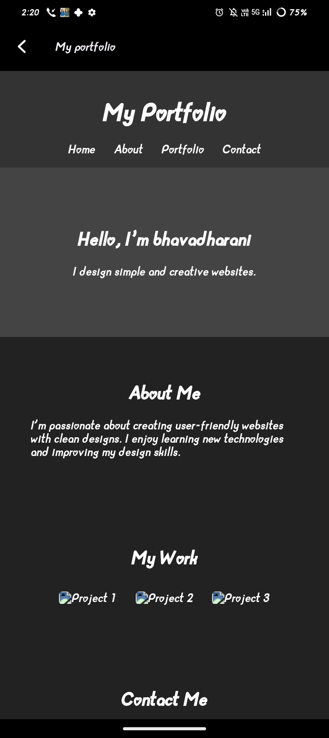

RESULTS AND SCREENSHOTS
3/21/2024 Annual Review
10

Slide 11
CONCLUSION
The digital portfolio provides a simple and effective platform for showcasing a
web designer’s skills, projects, and contact details.
It is user-friendly, responsive, and interactive, making it easy for potential clients o
r employers to view work and connect.
This project demonstrates how HTML, CSS, and JavaScript can be used to build a
professional portfolio website
11

